Slide 1
Does our portfolio actually generate risk-adjusted returns?
Presented by: Cecilia Zhou, Lawrence Kim, Harrison Li

Slide 2
Motivations
Build system to organize HFAC’s portfolio data for quantitative evaluation
Even if the value of our portfolio increases over time, does that actually mean we’re making good investments?
investing is not a tally of wins and losses
Quantitatively understand the performance of HFAC’s portfolio with respect to outside factors
In particular, exposures to systematic market trends

Slide 3
Calculating the value of our portfolio
TD Ameritrade provides transactions csv file
How to transform data into something useful?
transactions csv -> transaction objects -> portfolios
“portfolios” are snapshots of HFAC’s holdings for a given time period
Calculate portfolio values over time by querying Yahoo Finance API
price bought and sold doesn’t give us enough information
* certain stocks in our portfolio were left out of the calculation as they were acquired and delisted from the exchanges, so historical prices are no longer accessible

Slide 4
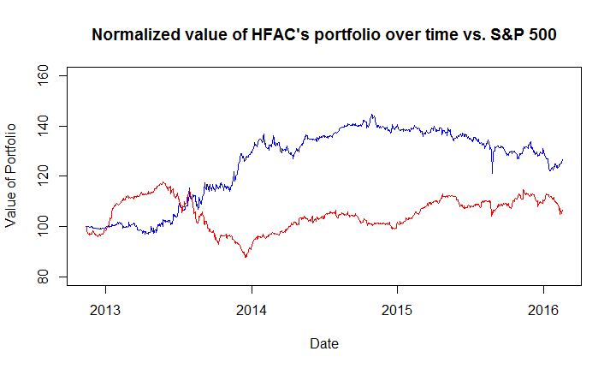
Portfolio value over time since late 2012

Slide 5

The Capital Asset Pricing Model
r = return of asset (i.e. HFAC’s portfolio)
α (“Jensen’s alpha”) = return in excess of market
β = change in asset return per unit increase in market return (same β as you learned in comp)
Here, “market” returns are defined as returns of S&P 500

Slide 6
Alpha
α essentially is a measure of the portfolio’s return in excess of the market
If you have zero alpha, no matter how high your returns are it’s “useless” according to CAPM since you could get the same return by being highly leveraged on the market
In reality, most hedge fund managers have zero/negative alpha
Efficient markets hypothesis

Slide 7
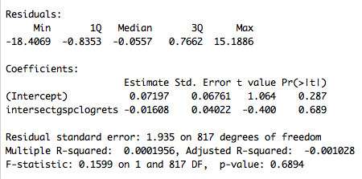
CAPM Results

Slide 8
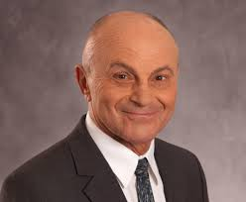
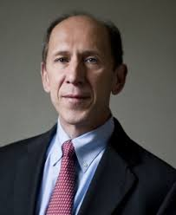
The Fama-French Three Factor Model

Slide 9
The Fama-French Three Factor Model
Developed by UChicago Nobel-prize winning economists Eugene Fama and Kenneth French
Noticed small stocks (low market cap) and value stocks (low P/B ratio) tend to generate systematically higher returns
Model “regresses out” these factors
If small/value stocks have consistently higher returns, why doesn’t everyone just invest in them?

Slide 10
The terms explained
SMB factor: return of small market cap portfolio minus return of large market cap portfolio
HML factor: return of value stock (low P/B) portfolios minus return of growth stock (high P/B) portfolios
Everything else is a carry-over from CAPM
Do you think alphas would be higher with Fama-French or CAPM? Why??

Slide 11
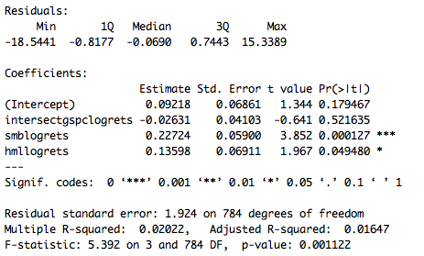
Fama-French Results

Slide 12
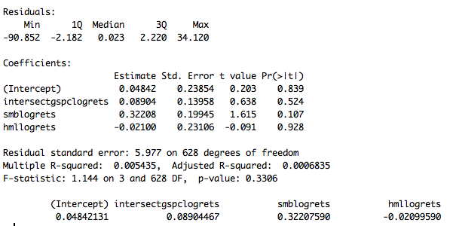
Owens Realty Mortgage, Inc. (ORM)

Slide 13
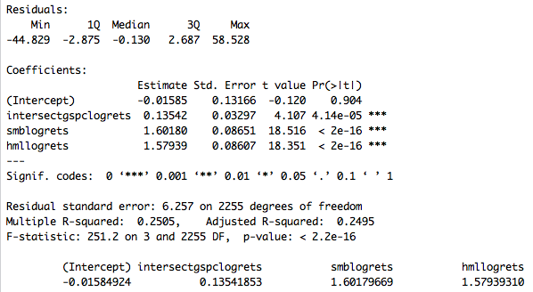
Consolidated-Tomoka Land Co. (CTO)

Slide 14
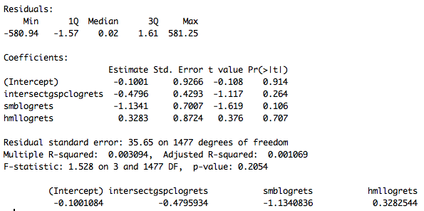
Parkit Enterprise Inc. (PKTEF)

Slide 15
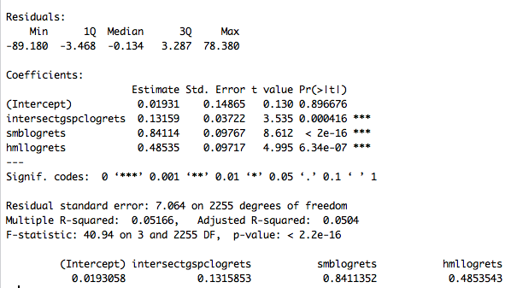
USA Truck, Inc. (USAK)

Slide 16
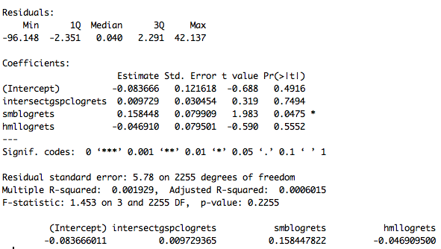
Power Reit (PW)

Slide 17
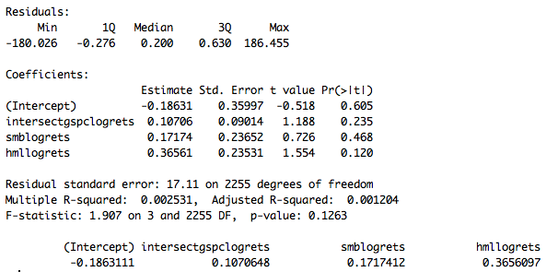
T.J.T., Inc. (AXLE)

Slide 18
Future Directions
Case-Shiller Index - Group of indices that tracks changes in housing prices in the United States
See how closely linked our portfolio is linked to this (especially with prevalence of real estate in portfolio)
Recently updated 3 Factor Fama-French Model to a 5 Factor Fama-French Model
Carhart (1997) added a momentum factor

Slide 19

Questions

